Slide 1




Parallel de novo Assembly of Complex (Meta) Genomes via HipMer
Aydın Buluç
Computational Research Division, LBNL
May 23, 2016
Invited Talk at HiCOMB 2016

Slide 2

Outline and Acknowledgments
  Joint work (alphabetical) with Chaitanya Aluru, Jarrod Chapman, Rob Egan, Evangelos Georganas, Steven Hofmeyr, Lenny Oliker, Dan Rokhsar, Kathy Yelick
Parallel De Bruijn Graph Construction and Traversal for de novo Genome Assembly, SC’14
A whole-genome shotgun approach for assembling and anchoring the hexaploid bread wheat genome. Genome Biology, 16(26), 2015.
meraligner: A fully parallel sequence aligner, IPDPS’15
HipMer: An Extreme-Scale De Novo Genome Assembler, SC’15
Work is funded by

Slide 3



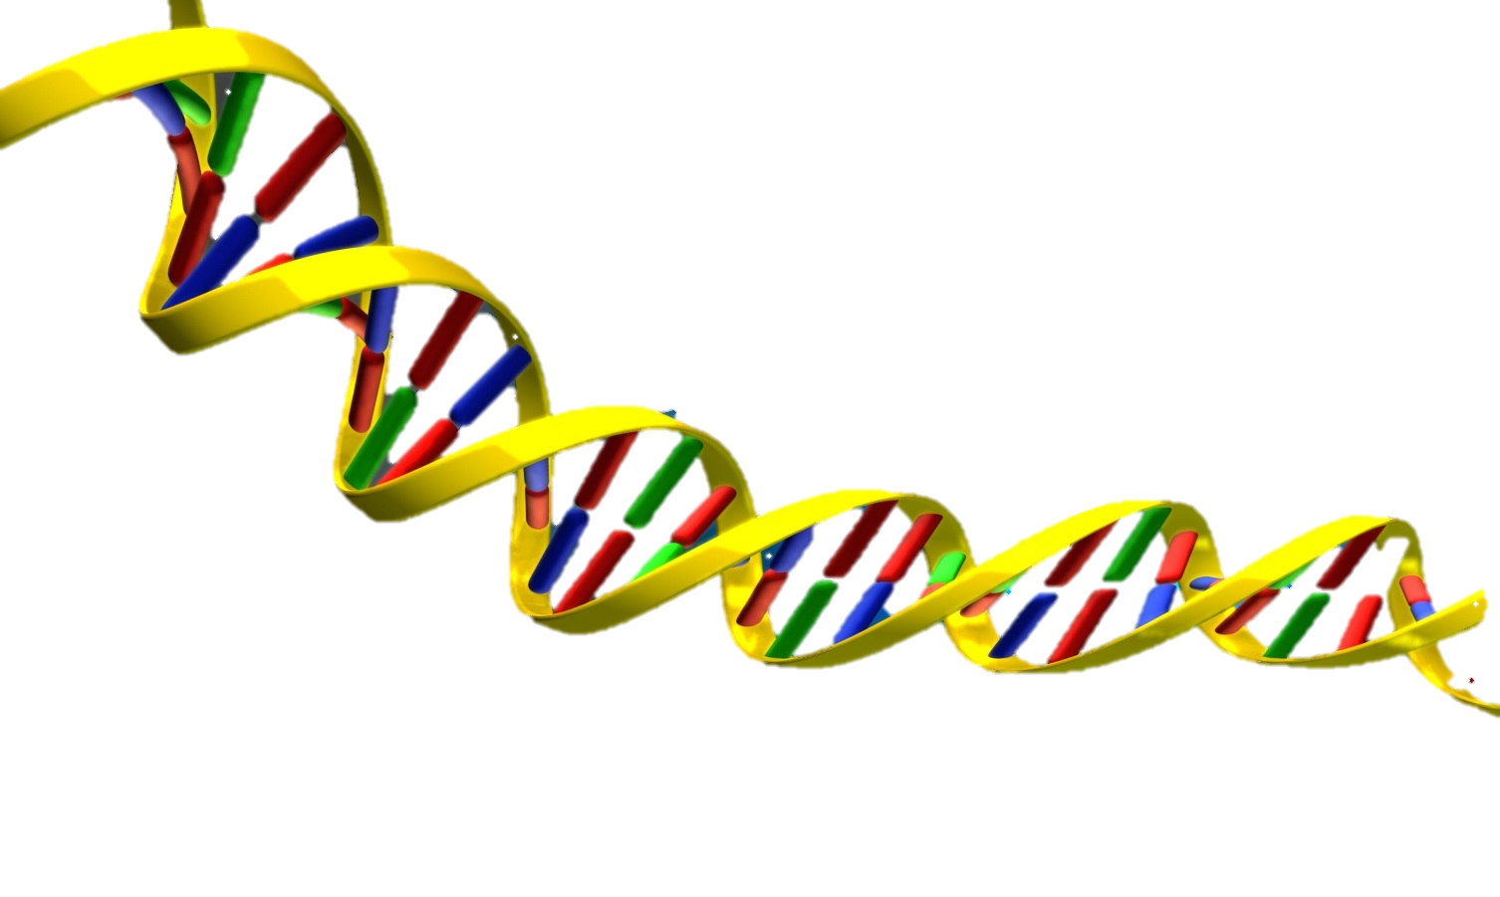

De novo Genome Assembly
1. Three copies of the same DNA.
1. Three copies of the same novel.
2. Some text from the novel. All pages will be randomly cut into strips of characters. Random typos (errors) throughout each novel.
2. Some part of the DNA sequence. It will be read into strips. There are random errors throughout the sequence.
For all men tragically great are made so through a certain morbidness… all mortal greatness is but disease.
ACCGTAGCAAAACCGGGTAGTCATACTACTACGTACTCATCT
3. A few strips of characters from one page.
3. The sequence is read into smaller pieces (reads). Can not read whole DNA sequence in one go.
For a
ally great
great are made so
all men tragically g
ACCGTAGCAA
AAACCGGGTA
TAGTCATACT
AAACCGGGTA
ACTACGTACT
4. All of the strips of characters from the 3 novels.
4. All reads
5. Every strip must be assembled as shown here to create a single copy of the novel.
5. Reconstruct original DNA sequence from the read set.
ACCGTAGCAAAACCGGGTAGTCATACTACTACGTACTCATCT
For all men tragically great are made so
ACCGTAGCAA
GTAGTCATACT
For a
great are made so
AAACCGGGTA
CTACTACGTAC
all men tragically g
ally great
CGTACTCATCT
Notes:
Read: short fragment of DNA sequence that can be read by a DNA sequencing technology – can’t read whole DNA in one go.
De novo genome assembly: Reconstruct an unknown genome from a collection of short reads.

Slide 4
De novo Genome Assembly is hard
There is no genome reference!
  In principle we want to reconstruct unknown genome sequence.
Reads are significantly shorter than whole genome.
  Reads consist of 20 to 30K bases
  Genomes vary in length and complexity – up to 30G bases
Reads include errors.
Genomes have repetitive regions.
  Repetitive regions increase genome complexity.
Notes:
So far it should be obvious that de novo genome assembly is hard! In particular:

Slide 5
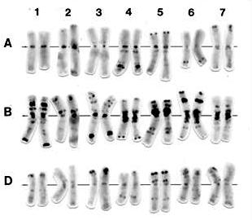
Genomes vary in size
Switchgrass: 1.4 Giga-base pairs (Gbp)
Maize: 2.4 Gbp
Miscanthus: 2.5 Gbp
Human genome: 3 Gbp
Barley genome: 7 Gbp
Wheat genome: 17 Gbp
Pine genome: 20 Gbp
Salamander: 20-30 Gbp
Notes:
In this cartoon we illustrate that the genomes can vary significantly in size. We highlight the human and the wheat genome since we used these data sets in our experiments.

Slide 6
Genome Assembly a la Meraculous
reads
Input: Reads that may contain errors
1
Chop reads into k-mers, process
k-mers to exclude errors
k-mers
I/O, bandwidth, and memory intensive
Construct & traverse de Bruijn graph of k-mers, generate contigs
2
contigs
Latency bound (irregular accesses)
3
Leverage read information to link contigs and generate scaffolds.
Compute and I/O intensive
scaffolds
Notes:
In this work we focus on a particular de novo genome assembler which is called meraculous.
This slide illustrates the de novo assembly pipeline implemented by Meraculous.

Slide 7
Meraculous parallelization with UPC
UPC is a PGAS (Partitioned Global Address Space) parallel language with one-sided communication.
Core graph algorithms implemented in UPC (graph ⬄ hash table).
We need the notion of a huge global distributed hash table.
Irregular access pattern in the the distributed hash table
  One-sided communication is handy!
Portable implementation: can run any machine without change!
Result of this work: Complete assembly of human genome in 8.4 minutes using 15K cores
Original code required 2 days and a large memory machine.

Slide 8
Parallel k-mer analysis: pass 1
Parallel Reduction
Create local Bloom filters
Reads
k-mer cardinality estimation
Parse to k-mers
Bloom Filter of size (G/n)
P₀
Hyperloglog
Bloom Filter of size (G/n)
P₁
Hyperloglog
G = Global cardinality estimation
Also identify
high-frequency k-mers
at this step
…
Bloom Filter of size (G/n)
P_{n}
Hyperloglog
Notes:
We do first a pass through the data set to create to estimate the size of the bloom filters

Slide 9
Parallel k-mer analysis: pass 2
All-to-all communication
of k-mers
Store a k-mer in the local set only if it was seen before
The local set does the actual counting of the k-mers
Reads
Hash k-mers & find owners
Parse to k-mers
P₀
Hash
k-mers
Received k-mers
Bloom Filter
Local set
P₁
Hash
k-mers
Received k-mers
Bloom Filter
Local set
…
P_{n}
Hash
k-mers
Received k-mers
Bloom Filter
Local set
Notes:
We perform then a second pass over the data in order to exclude erroneous k-mers, i.e. those that appear one time

Slide 10
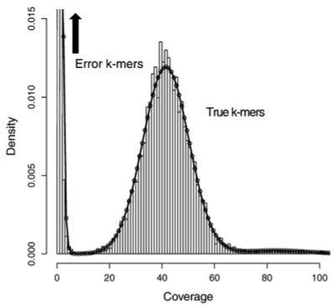
Why use a Bloom filter?
Bloom filter is a probabilistic data structure used for membership queries
Given a bloom filter, we can ask:
“Have we seen this k-mer before?”
No false negatives.
May have false positives
(in practice 5% false positive rate)
k-mers with frequency =1 are useless (either error or can not be distinguished from error), and can safely be eliminated.

Slide 11
Parallel k-mer analysis: pass 3
Use a threshold & find the high quality extensions of k-mers
Reads
Find extensions of k-mers, hash them & find their owners
Parse to k-mers
All-to-all communication
of k-mers and extensions
P₀
Hash
k-mers
Received
k-mers & extensions
Local set
ACCCA CT
CTTAG CF
AACCT TG
CGCAT XA
P₁
Hash
k-mers
Received
k-mers & extensions
Local set
AGGCA AT
GGTAG FF
AAAAT TG
CCCAT XX
Keep track of the number of occurrences of each extension for each k-mer
…
P_{n}
Hash
k-mers
Received
k-mers & extensions
Local set
TTCCA GT
TTTGC CA
AACTT GG
CTTTT CA
Notes:
Finally with a third pass we find for each error-free kmer the extensions in the read data set and we accept those with unique extensions

Slide 12
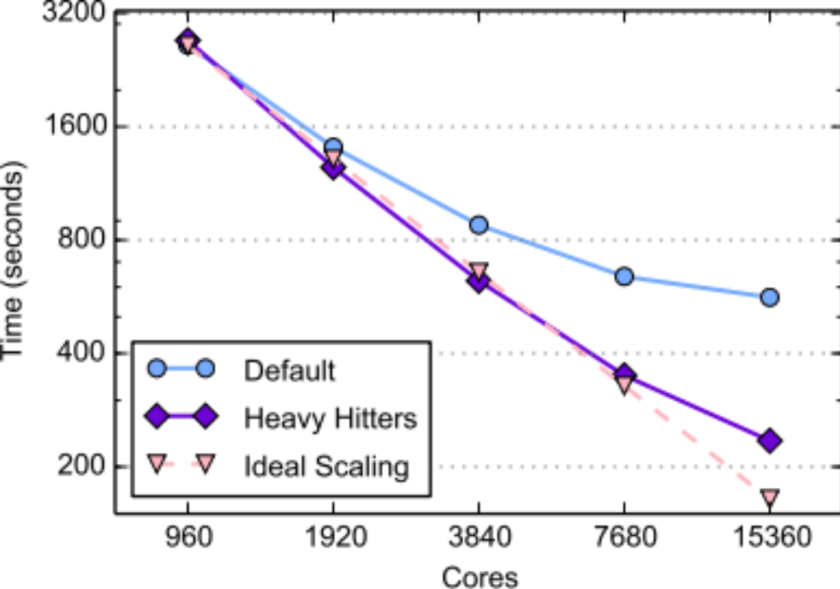
High-frequency k-mers
Long-tailed distribution for genomes with repetitive content:
The maximum count for any k-mer in the wheat dataset is 451 million
Our original scheme (SC’14) was “owner counts”, after an all-to-all
Counting an item w/ 451 million occurrences alone is load imbalanced
Solution: Quickly identify high-frequency k-mers using minimal communication during the “cardinality estimation” step and treat them specially by using local counters.
Notes:
Figure: Wheat genome k-mer analysis scalability before and after high-frequency k-mers optimization

Slide 13
Parallel De Bruijn Graph Construction
In Meraculous, the de Bruijn graph is represented as a hash table
K-mers are both nodes in the graph & keys in the hash table
An edge in the graph connects two nodes that overlap in k-1 bases
The edges in the graph are put in the hash table by storing the extensions of the k-mers as their corresponding values
CCG
ACC
AAC
GAT
ATC
TCT
CTG
TGA
AAT
ATG
TGC
Notes:
Show the overlap among the nodes

Slide 14
Parallel De Bruijn Graph Construction
Challenge 1: The hash table that represents the de Bruijn graph is large (100s of GBs up to 10s of TBs !)
  Solution: Distribute the graph over multiple processors. The global address space of UPC is handy!
Challenge 2: Parallel hash tables construction introduces communication and synchronization costs
  Solution: Aggregate messages to reduce number of messages and synchronization → 10x-20x performance improvement.

Slide 15
Aggregating stores optimization
Distributed
Hash table
P₀
Local buffer for P₀
Buffer local to P₀
Local to P₀
Local to P₀
Local buffer for P₁
P_{i}
P₀ stores the k-mers & extensions
in its local buckets in a lock-free & communication-free fashion
Local to P₀
…
Local to P₀
Local buffer for P_{n}

Slide 16
Parallel De Bruijn Graph Traversal
Goal:
Traverse the de Bruijn graph and find UU contigs (chains of UU nodes), or alternatively
find the connected components which consist of the UU contigs.
Main idea:
  Pick a seed
  Iteratively extend it by consecutive lookups in the distributed hash table
CCG
ACC
Contig 2: AACCG
Contig 1: GATCTGA
AAC
GAT
ATC
TCT
CTG
TGA
AAT
ATG
Contig 3: AATGC
TGC
Notes:
Main goal of traversal is to find connected components in the UU graph.

Slide 17
Parallel De Bruijn Graph Traversal
Assume one of the UU contigs to be assembled is:
CGTATTGCCAATGCAACGTATCATGGCCAATCCGAT
Notes:
Main idea of traversal: pick a seed and iteratively extend that by consecutive lookups in the distributed hash table.

Slide 18
Parallel De Bruijn Graph Traversal
Processor P_{i} picks a random k-mer from the distributed hash table as seed:
CGTATTGCCAATGCAACGTATCATGGCCAATCCGAT
P_{i} knows that forward extension is A
P_{i} uses the last k-1 bases and the forward extension and forms: CAACGTATCA
P_{i} does a lookup in the distributed hash table for CAACGTATCA
P_{i} iterates this process until it reaches the “right” endpoint of the UU contig
P_{i} also iterates this process backwards until it reaches the “left” endpoint of the UU contig
Notes:
Main idea of traversal: pick a seed and iteratively extend that by consecutive lookups in the distributed hash table.

Slide 19
Multiple processors
on the same UU contig
P_{i}
P_{j}
P_{t}
CGTATTGCCAATGCAACGTATCATGGCCAATCCGAT
However, processors P_{i}, P_{j} and P_{t} might have picked initial seeds from the same UU contig
Processors P_{i}, P_{j} and P_{t} have to collaborate and concatenate subcontigs in order to avoid redundant work.
Solution: lightweight synchronization scheme based on a state machine
Notes:
Main idea of traversal: pick a seed and iteratively extend that by consecutive lookups in the distributed hash table.

Slide 20

Alignment for
De novο Genome Assembly
reads
To be reused for metagenomics w/ modifications
1
k-mers
2
contigs
3
PARALLELIZING
SCAFFOLDING
scaffolds

Slide 21
Aligning queries to target sequences
A query and a target should match in at least k bases in order to be aligned
We call seed a substring of a sequence (query or target) with length equal to k
Read 90
Queries
(Reads)
Read 42
Targets
(Contigs)
Contig 101
Contig 61
Contig 500
Read ID start-pos end-pos Contig ID start-pos end-pos
--------------------------------------------------------------------------------------------------
Read 42 1 4 Contig 101 152 155
Read 42 130 150 Contig 61 1 21
Read 90 1 150 Contig 500 101 250

Slide 22
Building seed index
Seed Index
Target 0:
A C T G G
Target 1:
G G C A

Slide 23
Building seed index
Seed Index
Seed: ACT
•
Target 0:
A C T G G
Target 1:
G G C A

Slide 24
Building seed index
Seed Index
Seed: ACT
•
Seed: CTG
•
Target 0:
A C T G G
Target 1:
G G C A

Slide 25
Building seed index
Seed Index
Seed: ACT
•
Seed: CTG
•
Seed: TGG
•
Target 0:
A C T G G
Target 1:
G G C A

Slide 26
Building seed index
Seed Index
Seed: ACT
•
Seed: GGC
•
Seed: CTG
•
Seed: TGG
•
Target 0:
A C T G G
Target 1:
G G C A

Slide 27
Building seed index
Seed Index
Seed: ACT
•
Seed: GGC
•
Seed: CTG
•
Seed: TGG
•
Seed: GCA
•
Target 0:
A C T G G
Target 1:
G G C A
Notes:
Since this is the same “k”, each k-mer only exists in one unique contig so the seed index can not point to multiple targets

Slide 28
Lookup seed index
query’s seed
query sequence : G C T G
Seed G C T is not found in seed index
Seed Index
Seed: ACT
•
Seed: GGC
•
Seed: CTG
•
Seed: TGG
•
Seed: GCA
•
Target 0:
A C T G G
Target 1:
G G C A
Notes:
This is the same idea as in graph construction vs traversal.
First we build, which is write-only; then we lookup which is read-onlu

Slide 29
Lookup seed index
query’s seed
query sequence : G C T G
Seed Index
Seed: ACT
•
Seed: GGC
•
Seed: CTG
•
Seed: TGG
•
Seed: GCA
•
Target 0:
A C T G G
Target 1:
G G C A
Notes:
There is an “exact match” optimization we used extensively but I am not going to go through the details here.

Slide 30
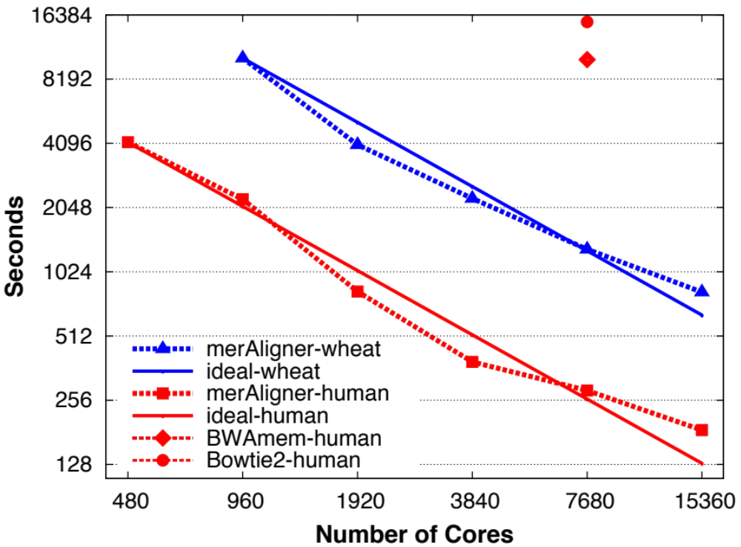
Parallel Genome Alignment for
De novo Assembly
In de novo assembly, billions of reads must be aligned to contigs
First aligner to parallelize the seed index construction (“fully” parallel)
Evangelos Georganas, Aydın Buluç, Jarrod Chapman, Leonid Oliker, Daniel Rokhsar, and Katherine Yelick. meraligner: A fully parallel sequence aligner. In Proceedings of the IPDPS, 2015.
Notes:
Joint work with MANTISSA (ASCR Data), DEGAS (ASCR X-Stack), JGI (BER)
This publication covers the last step in the previous slide
Alignment is the biggest step of “scaffolding”

Slide 31
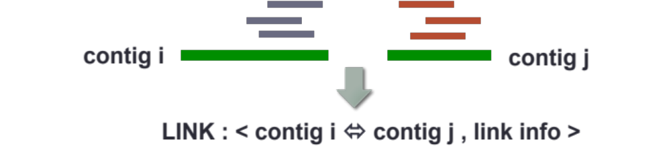
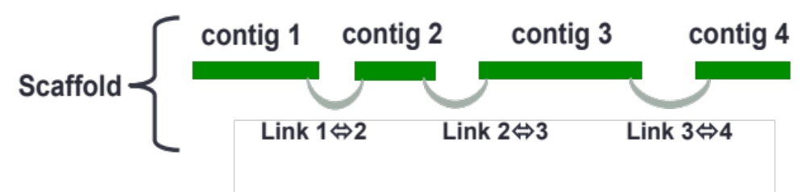
Scaffolding beyond alignment
High-level idea: Leverage read-to-contig information to generate links among contigs.
  Distributed hash tables to index the link information.
Form a contig graph by using the links and traverse it to form scaffolds.

Slide 32
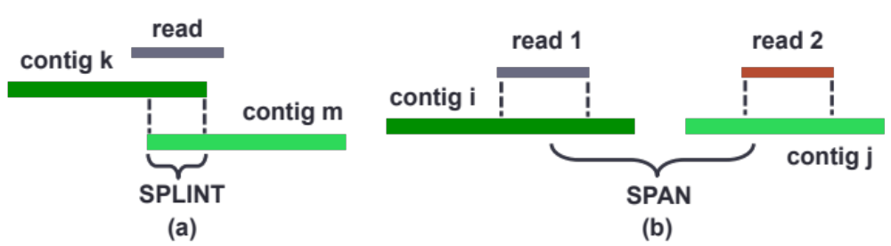
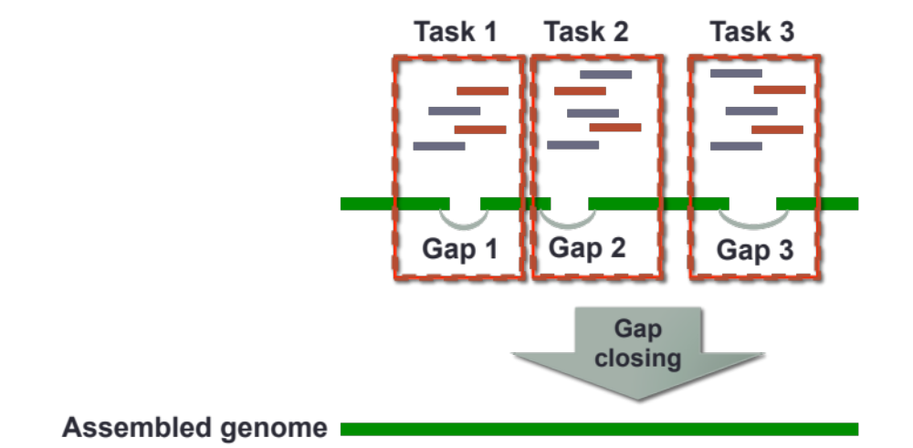
Scaffolding beyond alignment
Computing contig depths and termination states
Contig bubble identification (for diploid genomes)
Ordering and orientation of contigs (inherently serial as implemented)
Insert size estimation
Locating splints and spans
Contig link generation
Gap closing
Conceptually: Mini/local assembly
– embarrassingly parallelizable -
Tools employed:
Distributed hash tables
Speculative execution

Slide 33
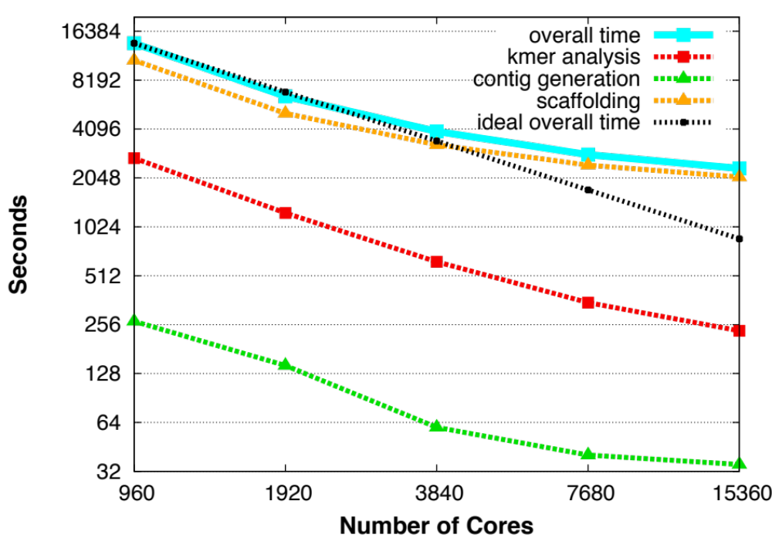
Strong scaling (wheat genome)
on Cray XC30
Complete assembly of wheat genome in 39 minutes (15K cores).
Original Meraculous would require (projected time) a week (~300x slower) and a shared memory machine with 1TB memory.

Slide 34
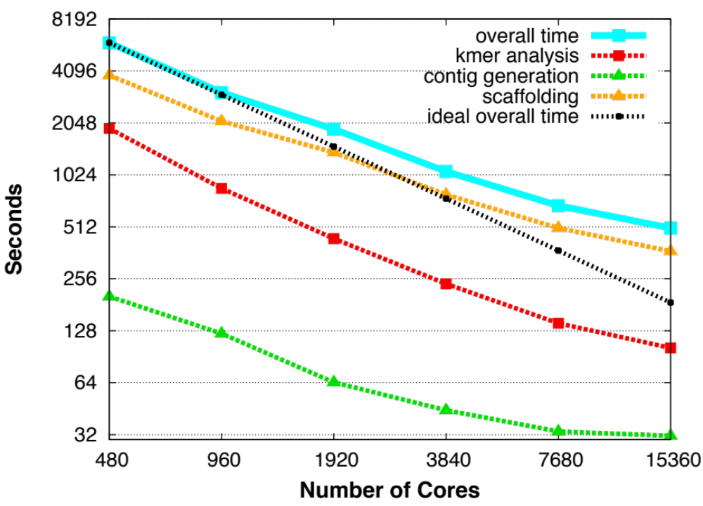
Strong scaling (human genome)
on Cray XC30 @SC’15
Complete assembly of human genome in 8.4 minutes (15K cores).
350x speedup over original Meraculous (took 2,880 minutes and a large shared memory machine).

Slide 35
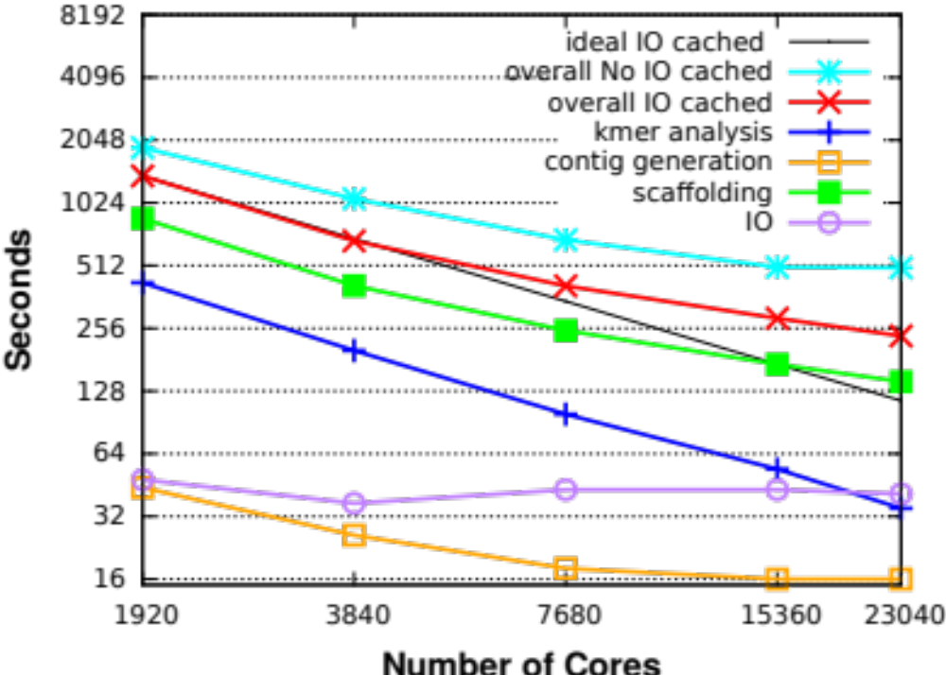
Strong scaling (human genome)
on Cray XC30 @Now
Complete assembly of human genome in 4 minutes using 23K cores.
700x speedup over original Meraculous (took 2,880 minutes and a large shared memory machine).

Slide 36






How about metagenomes?
Instead of multiple copies of the same book, how you have the whole library to assemble!
1984 is the “dominant species” in this sample.
Too easy: there are also previously unknown books in the mix.
Option 1: Bin the reads to genomes; run single genome assembly
Reads are too short to contain enough information for binning.
Option 2: Generate contigs and bin the contigs
☹ How do you eliminate errors for low-coverage organisms?

Slide 37
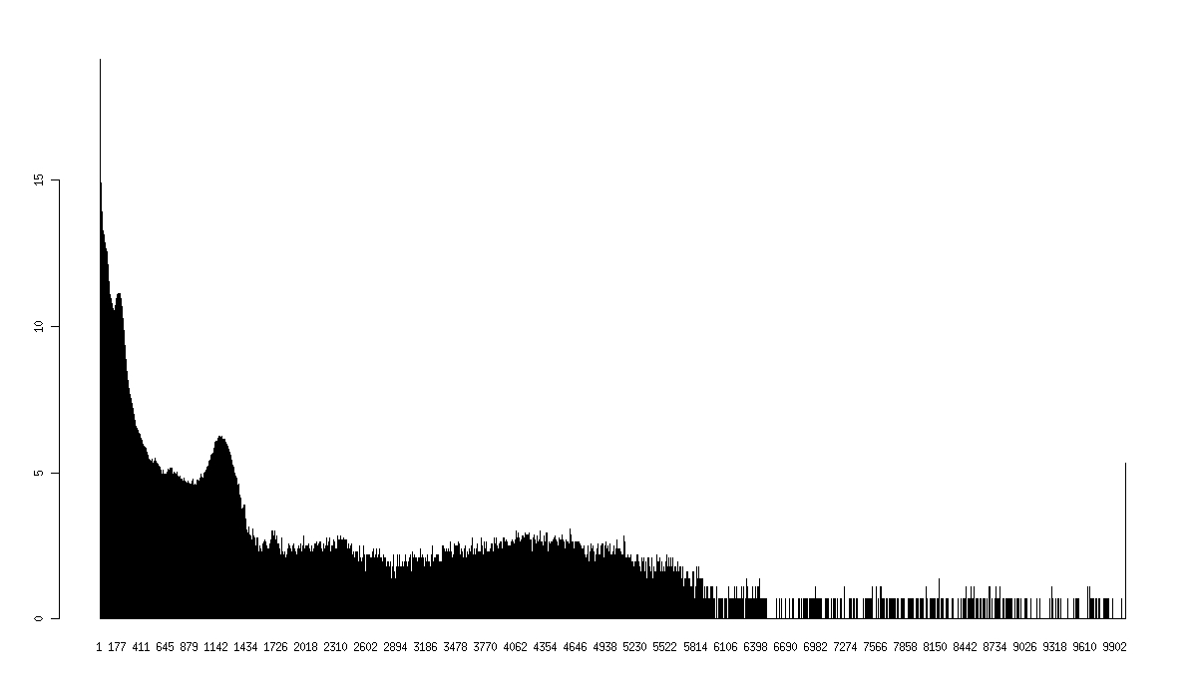
Metagenome challenges
- Why does metagenome assembly benefits from explicit error correction when single genome assembly does not?
+ Uneven sequencing depth: Errors in high-depth regions might be more frequent than true k-mers in low-depth regions.
- Who cares about low-depth regions?
+ In fact, that’s what matters most.
Single genome
Metagenome

Slide 38
Adapting HipMer to metagenomes
Inputs: (A) Short reads and (F) long insert (mate paired) libraries
Intermediate: (B) Error-free k-mers w/ extensions (a.k.a. UFX), (C) contigs…
Output: (G) final genome scaffolds
A
persistent
A
A
10TB
F
G
B
B
D
D
D
Data sizes
1TB
E
E
100GB
C
C
C
C
C
Secret metagenome sauce #1
k-mer
analysis
contig
generation
alignment
scaffolding
gap closing
Increase k and iterate

Slide 39
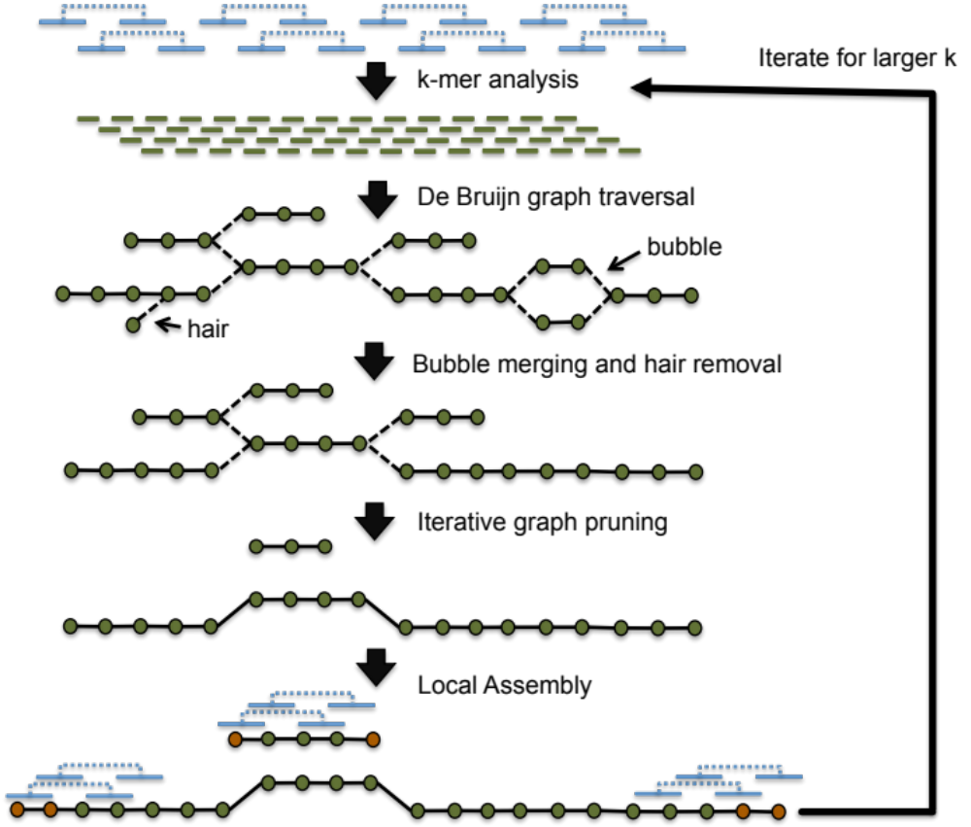
Iterative contig generation

Slide 40
Iterative contig generation

Slide 41
Iterative contig generation

Slide 42
Iterative contig generation

Slide 43
Iterative contig generation

Slide 44
Iterative contig generation

Slide 45
Iterative contig generation

Slide 46
HipMer on a MOCK community
  Mix of 25 bacteria with different abundancies (JGI dataset)
  Dataset size ~ 100 GBytes
Statistics | metaHipMer | metaSPAdes
# contigs | 2,670 | 5,100
Total length > 10 kbp | 92,245,198 | 92,152,728
Total length > 50 kbp | 69,493,125 | 77,292,121
Misassemblies | 58 | 134
Mismatches per 100 kbp | 3.48 | 77.05
Genomes fraction (%) | 92.10 | 91.10

Slide 47
Summary
HipMer’s core algorithms scale to tens of thousands of cores and yield
performance improvements from days/weeks down to minutes.
HipMer breaks the hardware limitations by enabling distributed-memory scaling
Use of de novo assembly in time sensitive applications like precision medicine is no more formidable!
Source release of HipMer : https://sourceforge.net/projects/hipmer/
Ongoing work: Adapt HipMer for metagenomic analysis (some hints and preliminary results given in this talk).

